Slide 1
Data, Environment and Society Lecture 7: Visualization
September 13, 2018
Instructor: Duncan Callaway
GSI: Seigi Karasaki

Slide 2
Announcements
Josh Apte next Tuesday
Lab due tomorrow
HW3 due Tuesday
Read Lee et al
We will be posting polls to get feedback on homeworks and labs, stay tuned.

Slide 3
Outline
Update on merge types
Principles of visualization
Types of plots
Ways to customize plots
Throughout, (hopefully) have fun looking at cool charts.

Slide 4
Merging update
http://www.datasciencemadesimple.com/join-merge-data-frames-pandas-python/
Natural join: To keep only rows that match from the data frames, specify the argument how=‘inner’. Default in pandas.
Full outer join: To keep all rows from both data frames, specify how=‘outer’.
Left outer join: To include all the rows of your data frame x and only those from y that match, specify how=‘left’.
Right outer join: To include all the rows of your data frame y and only those from x that match, specify how=‘right’.

Slide 5
Let’s just look at some cool pictures

Slide 6
Notes:
nice representation of time -- without it this graph would be very misleading!
Dates provide context, which is nice.

Slide 7
Notes:
* colors give categorical data
* names labeled
* detail blurred where unimportant
* bold where they want to make a point.

Slide 8
Notes:
* All on same scale
* creative legend
* entertaining graphics

Slide 9
Notes:
rank vs time. What’s good?
- color highlights
- text labels
- many categories together -- can see trends quickly

Slide 10
Notes:
time vs score enhanced by
- use of color
- text labels
- different symbols

Slide 12
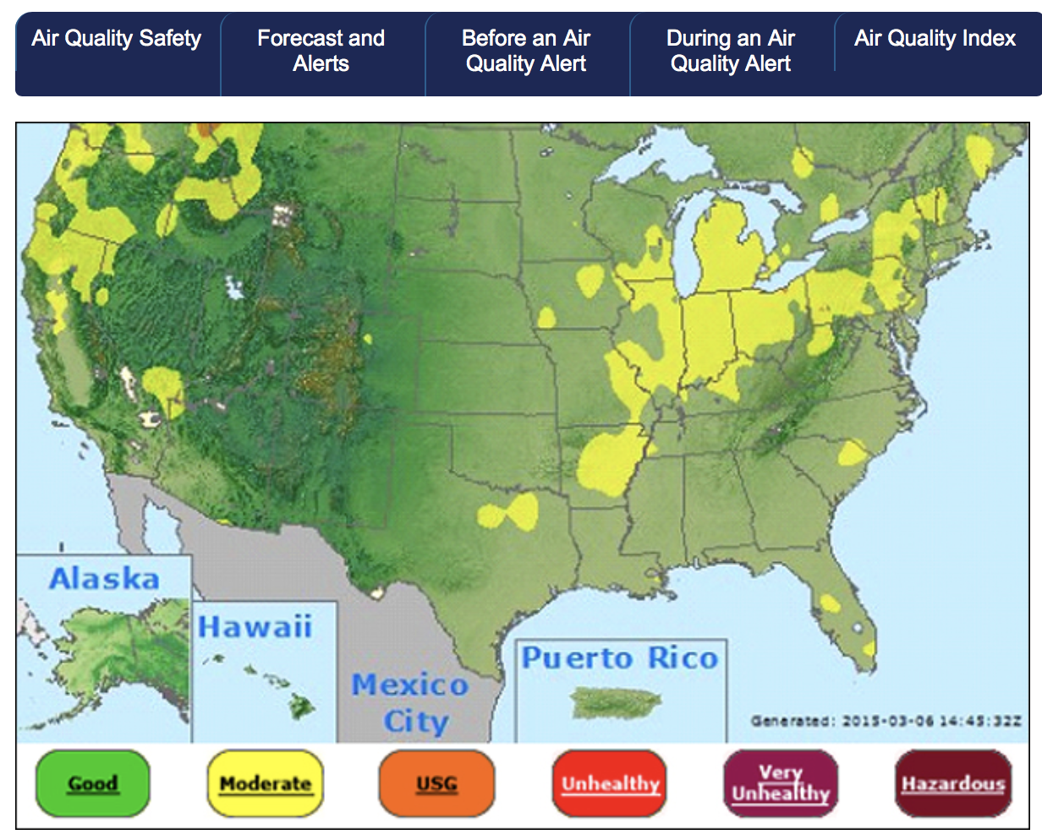

Slide 13
Napoleon
Notes:
how many dimensions / variables displayed?
* location in space
* direction of travel
* number of troops
Temperature
time

Slide 14
Principles of visualization
Scale
Conditioning
Perception
Transformation
Context
Smoothing

Slide 15
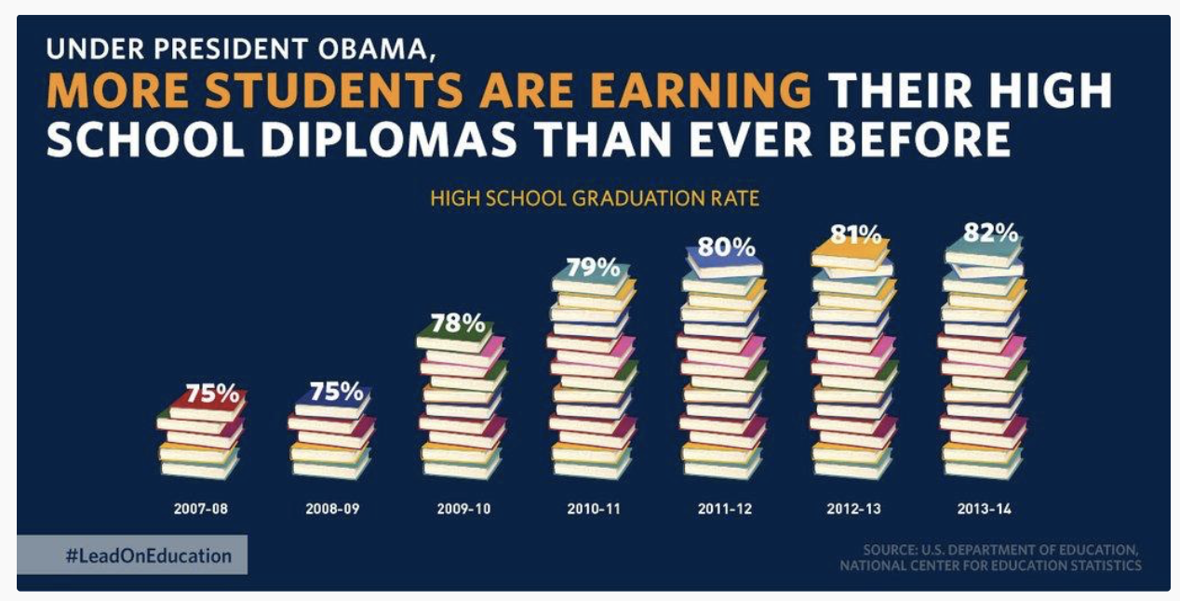
Scale
How would you fix this chart?

Slide 16
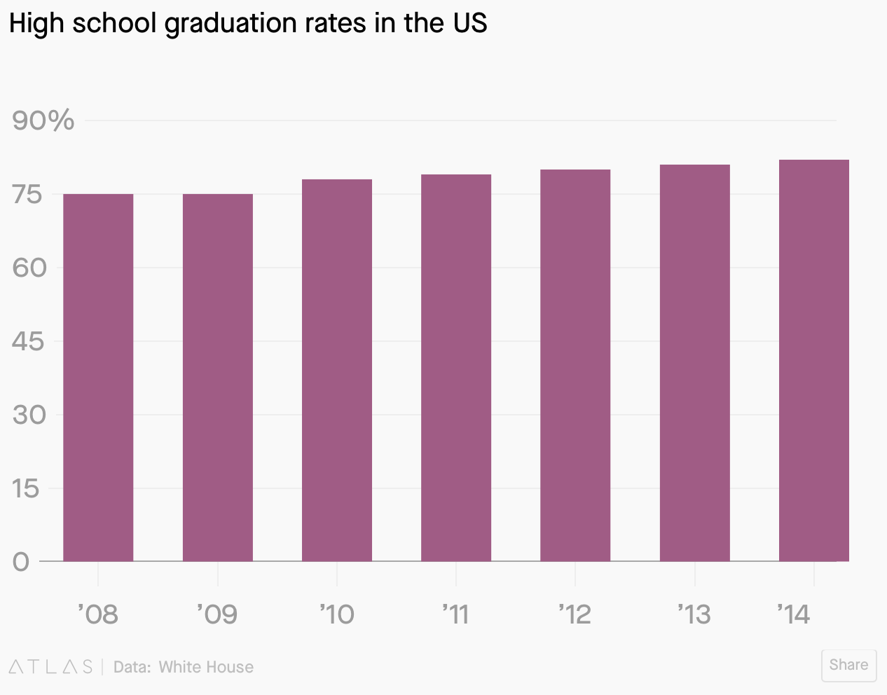
Scale, ctd
Fixed?
Not necessarily – though y-axis starts at zero (often a good thing) what we really want to know is how things are changing over time.

Slide 17
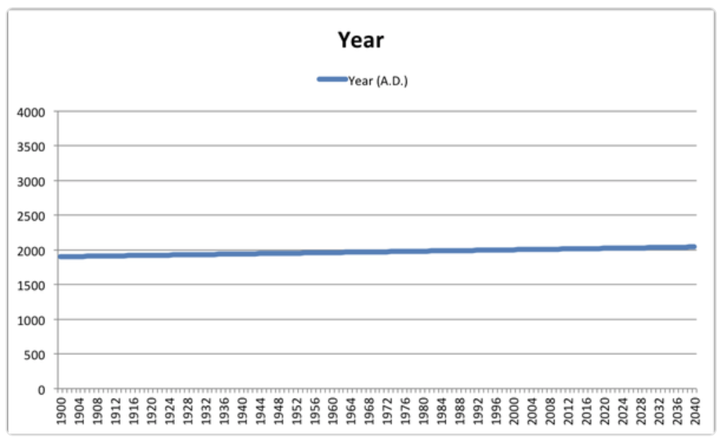
Scale: we shouldn’t always start at zero…
Notes:
Yahoo finance produced this figure (but anyone could if they wanted to spend a minute of their own time doing it)

Slide 18
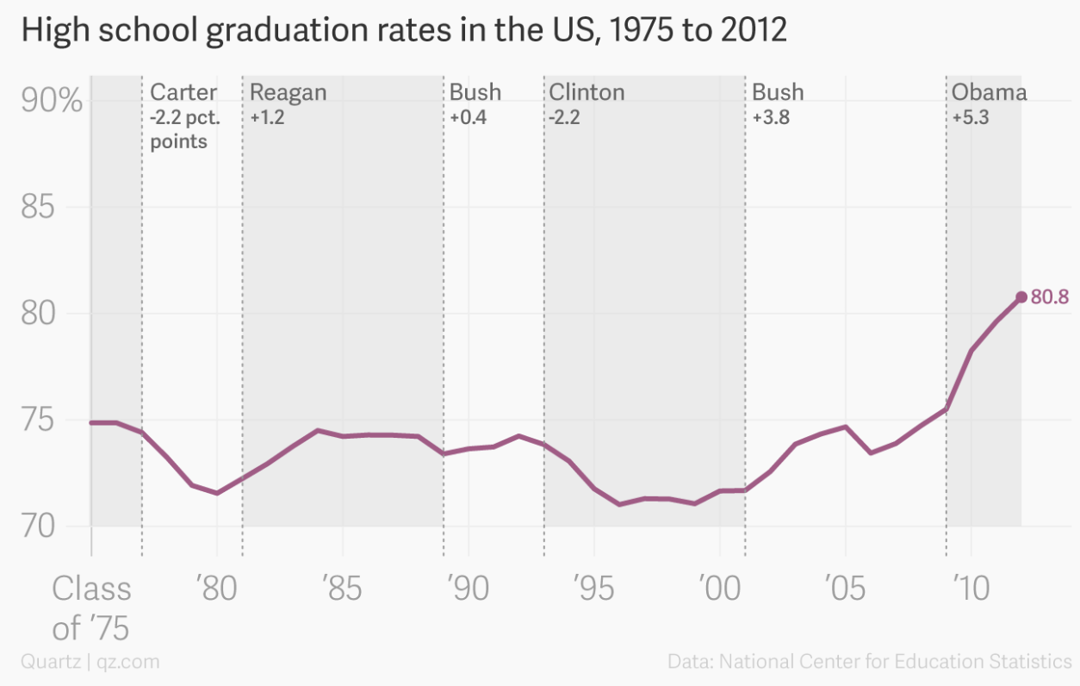
Scale, ctd
Education plot fixed?
We see comparisons to other administrations
We see changes over a longer period of time
(note, these data are from a slightly different data set than the data in the first two graduation charts)

Slide 19
Principles of visualization
Scale
Conditioning
Perception
Transformation
Context
Smoothing

Slide 20
Conditioning
What does conditioning mean, in the context of visualization?
To subgroup the data to see relationships between different groups of interest

Slide 21
Conditioning example
Taken from Callaway, Fowlie and McCormick JAERE (2018)
Notes:
Taken from Callaway, Fowlie and McCormick JAERE (2018)

Slide 22
Revisiting Julia
Notes:
time vs score enhanced by
- use of color
- text labels
- different symbols

Slide 23
Principles of visualization
Scale
Conditioning
Perception
Transformation
Context
Smoothing

Slide 24
Perception
Some principles:
We perceive some colors more strongly than others (especially greens)
We perceive lighter shaded areas as larger than darker shaded ones.
An under-appreciated issue: color-blindness.

Slide 25
What might you change to adjust perception?
Notes:
Colors
We perceive red more strongly – eyes drawn there
..but yellow looks bigger.

Slide 26
Not color blind

Slide 27
Color blind

Slide 28
Perceptually uniform Color palettes – quantitative data
Perceptually uniform: equal steps in data are perceived as equal steps in the color space
A few perceptually uniform matplotlib color maps
Good when you want to represent a quantity in space

Slide 29
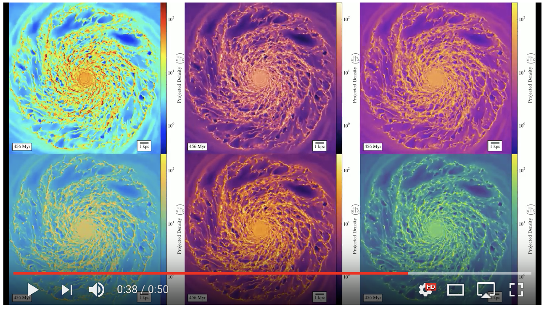
jet
magma
plasma
parula
inferno
viridis
Nathan Goldbaum's galaxy formation simulation video
Notes:
jet

Slide 30
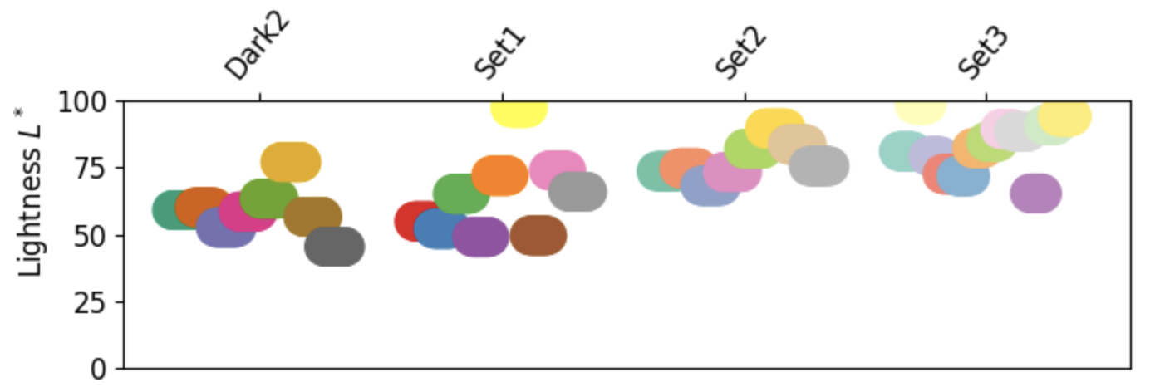
Qualitative / categorical colormaps
Often used for representing quantity in an area or line – colors distinguish between different categories rather than quantities.
A few matplotlib quantitative colormaps:

Slide 31
Example: Set3 palette for categorical data
https://vincent.readthedocs.io/en/latest/charts_library.html

Slide 32
Notes:
rank vs time. What’s good?
- color highlights
- text labels
- many categories together -- can see trends quickly

Slide 33
Principles of visualization
Scale
Conditioning
Perception
Transformation
Context
Smoothing

Slide 34
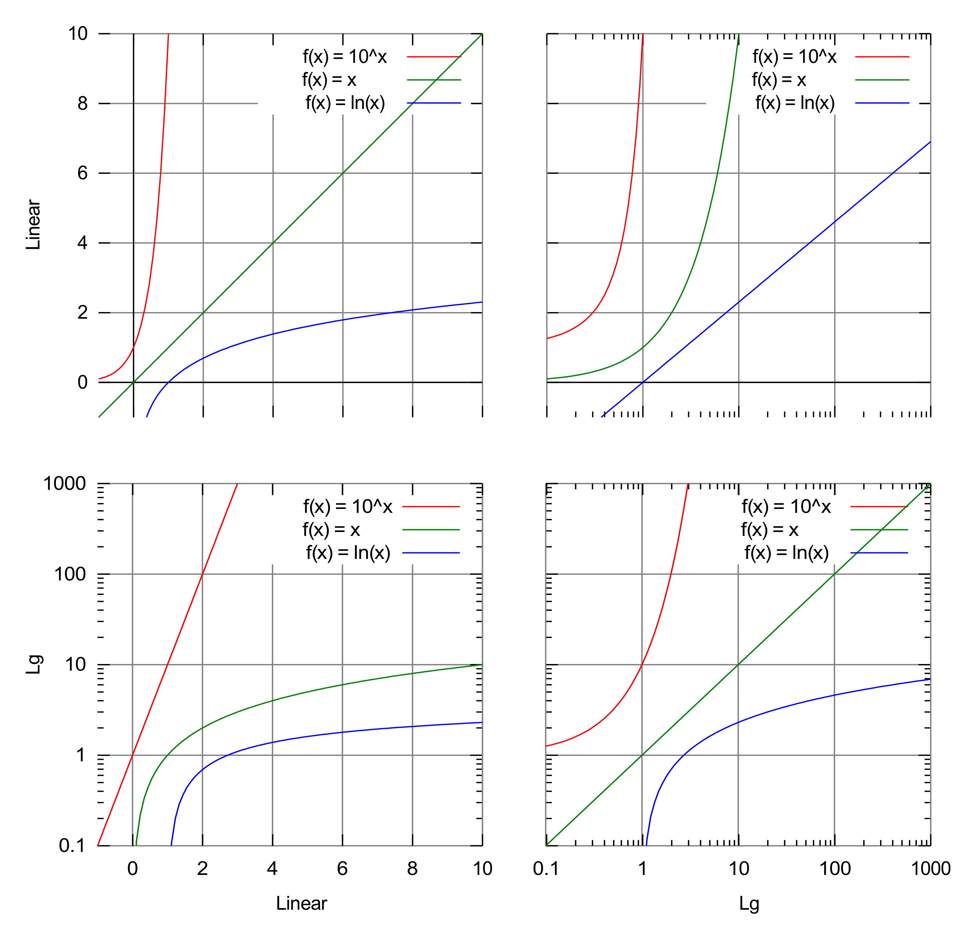
Transformation
Log transform is the “swiss army knife” transformation
Squashes down big numbers; makes it easier to see small numbers on the same axis.
By Autopilot - Own work, CC BY-SA 3.0, https://commons.wikimedia.org/w/index.php?curid=10733854

Slide 35
Power laws

Slide 36
Principles of visualization
Scale
Conditioning
Perception
Transformation
Context
Smoothing

Slide 39
Notes:
* colors give categorical data
* names labeled
* detail blurred where unimportant
* bold where they want to make a point.

Slide 40
Notes:
nice representation of time -- without it this graph would be very misleading!
Dates provide context, which is nice.

Slide 41
Types of plots

Slide 42
Plot types we’ll talk about today
Distributions:
Rugplot
Histogram
Kernel density
Box and whisker
Scatter plots
Line plots
Bar charts
Three dimensional plots
Geographic maps
Heat maps, contour maps
Scatter plots

Slide 43
Rugplots
Here, plotting the age of each member of a population (passengers on the Titanic)

Slide 44
Histograms
Plots count (number of observations) versus a single variable
Here, same distribution at rug plot on previous slide

Slide 45
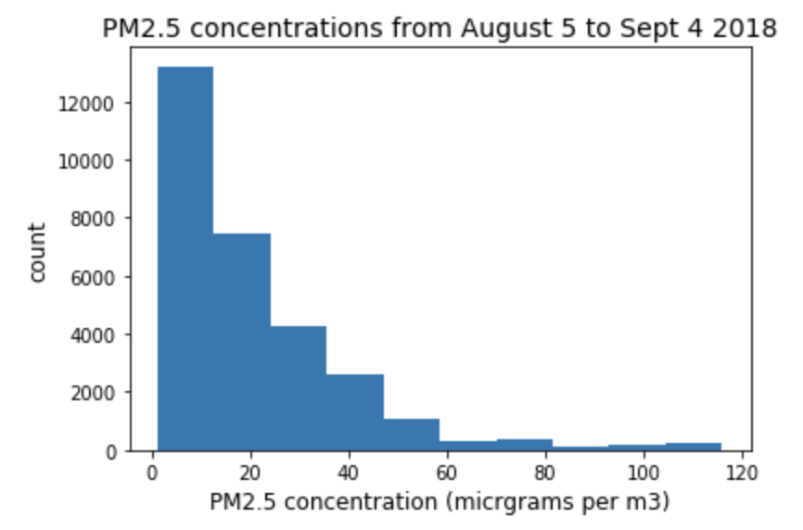
Tuesday’s histogram (Ecole Bilingue)

Slide 46
Smoothing with kernel density estimates
Start with a set of values spread on the x-axis (here just three)
Put a Gaussian distribution over each one
Add up the Gaussian distributions, then re-scale so the area under the curve is 1
Notes:
Start with a set of values spread on the x-axis (here just three)
Put a Gaussian distribution over each one
Add up the Gaussian distributions, then re-scale so the area under the curve is 1

Slide 47
Why normalize the kernel density estimate curve so the area = 1?
The KDE is an estimate of the probability distribution of values in the population
Definition of the probability distribution is that the probability of an event happening in a particular range is the integral of the curve over that range
Total probability can’t be greater than one, so we normalize.

Slide 48
The KDE “bandwidth”
We can vary the width of the Gaussian distribution we overlay on each point. We call this width the bandwidth
What would be the effect on the final KDE plot of…
Reducing the bandwidth?
Growing the bandwidth?

Slide 49
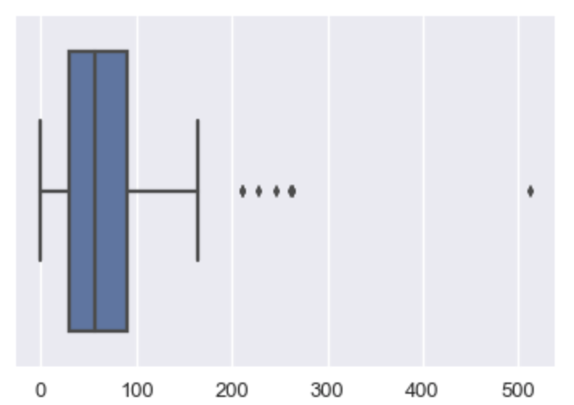
Box and whisker plots
“box”
Display similar information to a histogram, but abstracted:
Median
“Interquartile range” (IQR; 25th to 75th percentile)
Whiskers located
1.5 times the IQR away from the 25th or 75th percentile, or
At the last data point on that side of the distribution
Data points more than 1.5 times the IQR away from the 25th or 75th percentile are shown individually
“whisker”
Notes:
“box”

Slide 50
Quick notes on box and whisker
Nice for comparing distributions
They gloss over a lot of detail
Parameter defaults are adjustable:
25th and 75th percentile → Xth and Yth percentile (you can choose)
Whiskers at 1.5 times IQR → Z times IQR (you can choose)
But most boxplots done with the standard parameter values we list here.

Slide 51
Same distributions, different ways to plot
DS100 textbook
Notes:
DS100 textbook

Slide 52
Scatter plots

Slide 53
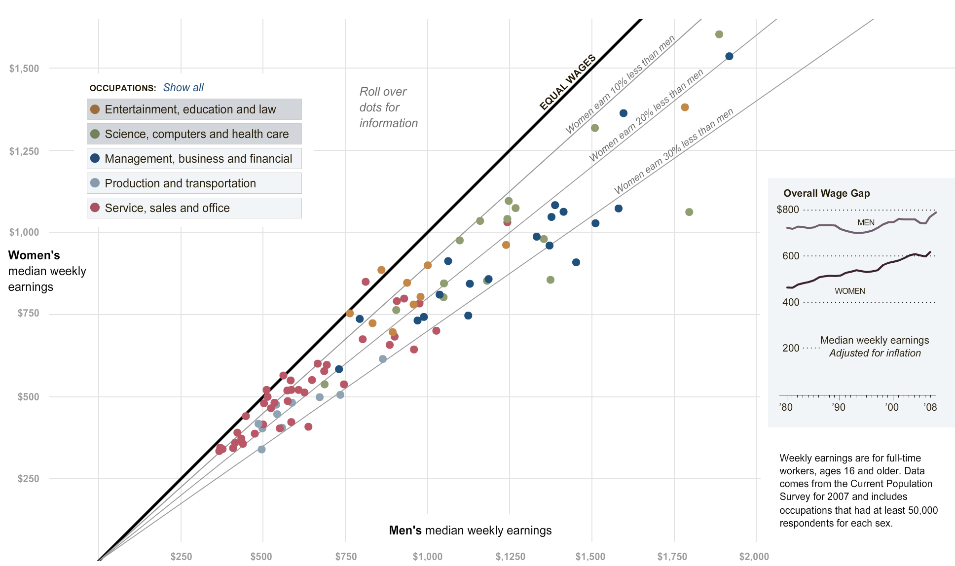
https://archive.nytimes.com/
Notes:
nytimes.com

Slide 54
Scatter plots – things to adjust
Symbol shape → category
Symbol size → additional quantitative data
Symbol color → additional quantitative data or category
Labels → context

Slide 55
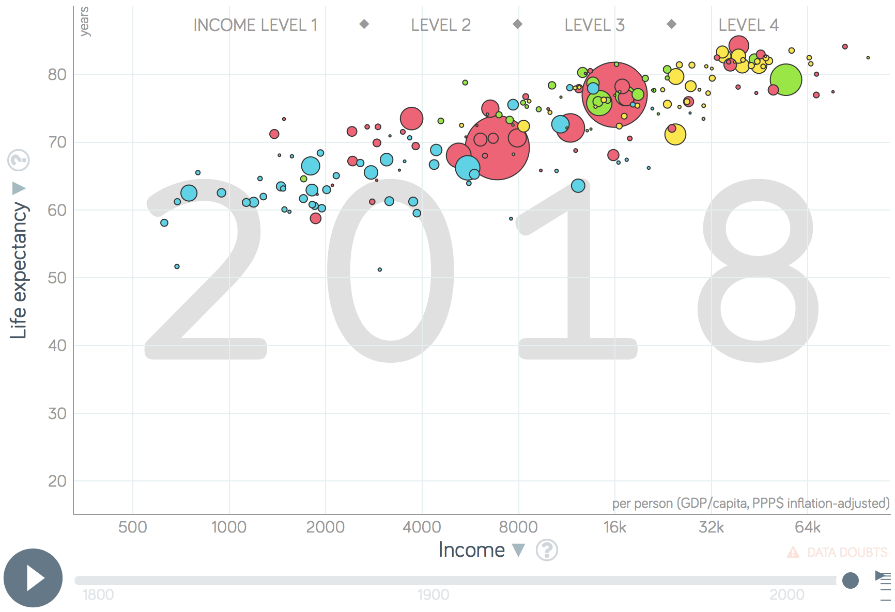
gapminder.org
Notes:
gapminder.org

Slide 56
Line plots
Versus scatter, line plots connect measurements ”in order”
In cases where measurements are taken infrequently in time, this might help to visually interpolate what happened between measurements
It also gives a clear sense of sequence or correlation

Slide 57
538
Notes:
nice representation of time -- without it this graph would be very misleading!

Slide 58
Notes:
* colors give categorical data
* names labeled
* detail blurred where unimportant
* bold where they want to make a point.

Slide 59
Notes:
* All on same scale
* creative legend
* entertaining graphics

Slide 60
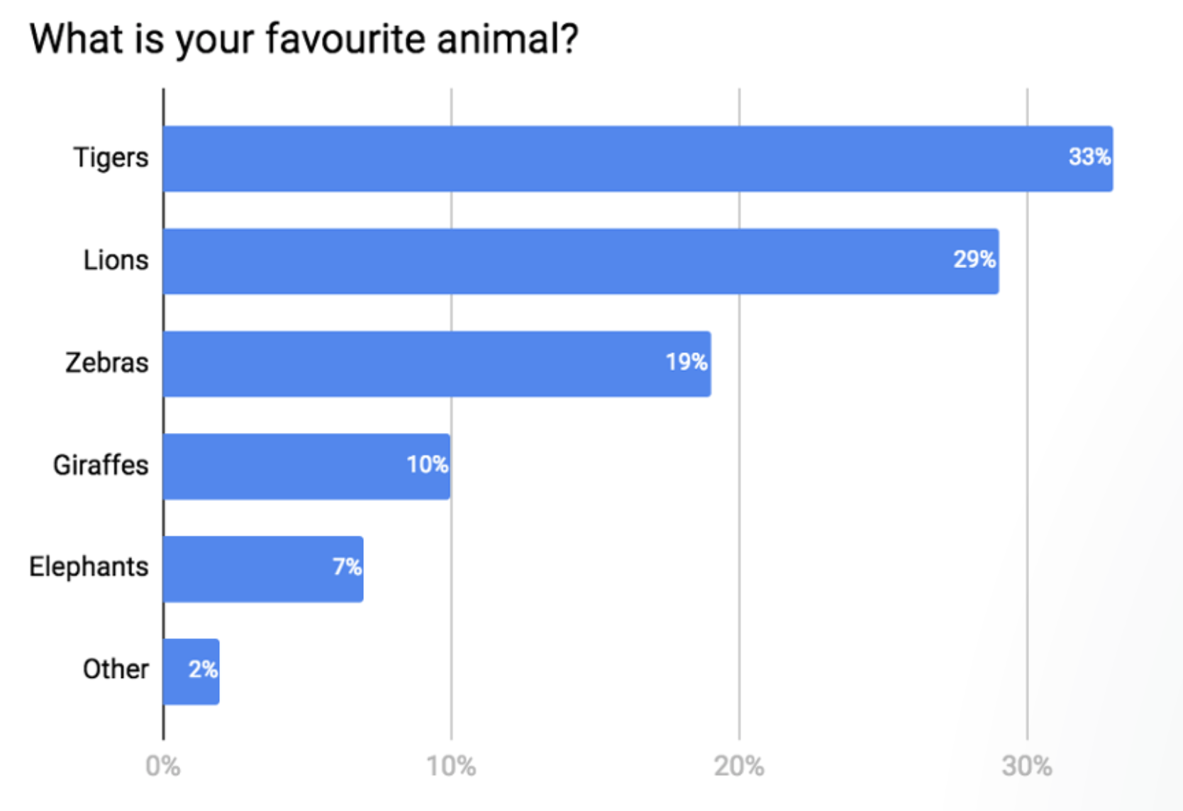
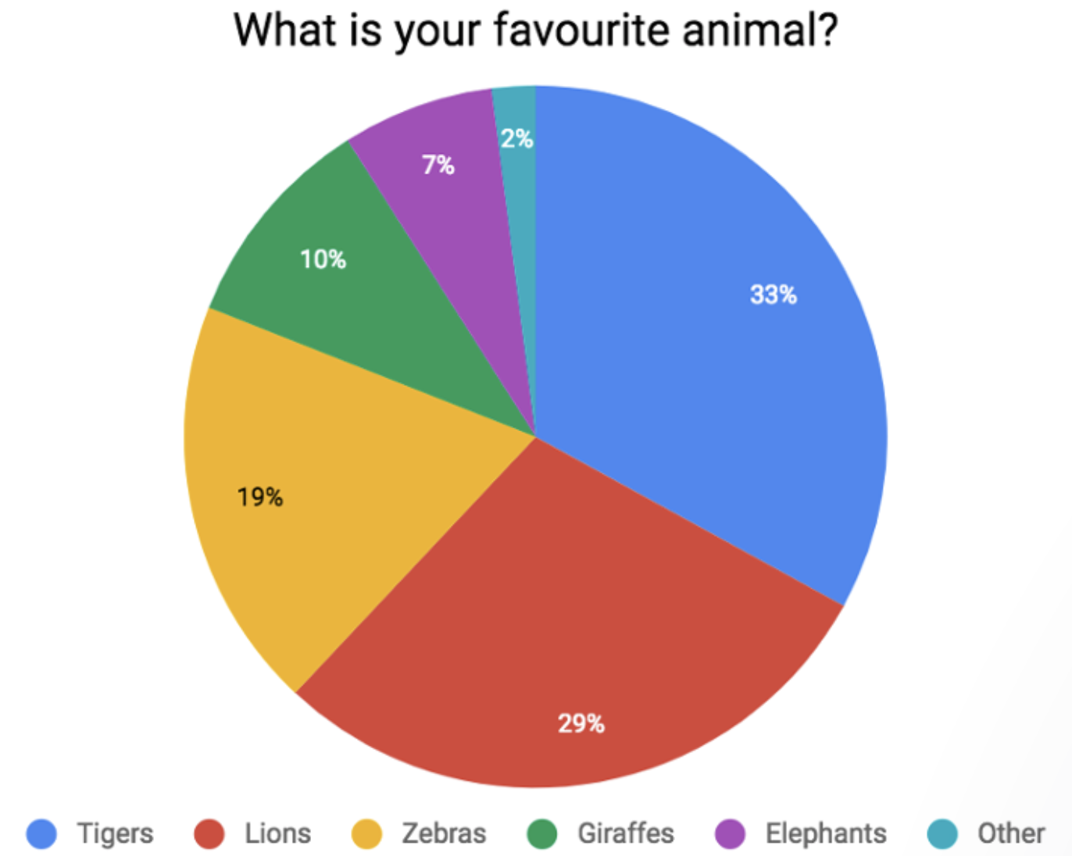
Bar charts
Display quantity of interest across many different categories.
You can do similar things with Pie charts, but they require comparing area (two dim.) which is harder than comparing length (one dim)
https://blog.funnel.io/why-we-dont-use-pie-charts-and-some-tips-on-better-data-visualizations

Slide 61
Conditioning Bar chart example
Notes:
Taken from Callaway, Fowlie and McCormick JAERE (2018)

Slide 62
Three (and more) dimensional data
Heat maps
Contour plots
Scatter plots with symbol size

Slide 63
Napoleon
Notes:
how many dimensions / variables displayed?
* location in space
* direction of travel
* number of troops
Temperature
time

Slide 64
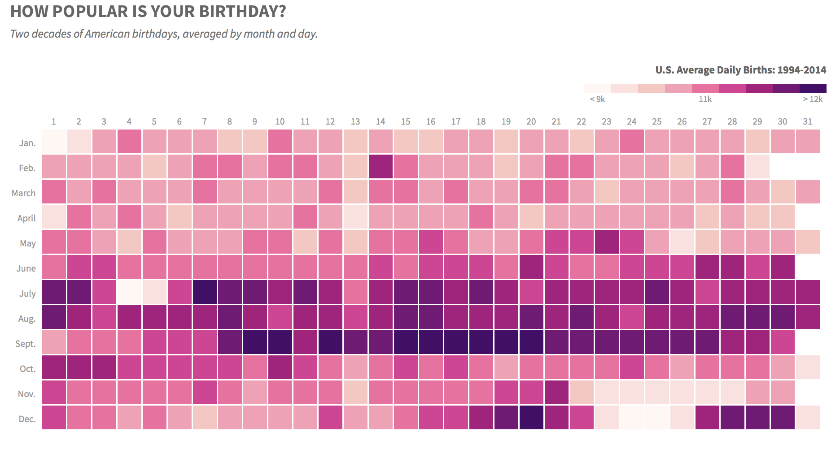
thedailyviz.com
Notes:
thedailyviz.com

Slide 66
Customizing plots
Where to use text
At a minimum: x-label, y-label, title
Might also be relevant: legend, labeling features on the figure
Symbols on line and scatter plots
Colors – we’ve discussed already…
Line width – use your judgment
Font size
Title largest
Axis labels medium
Tick labels smallest
Font type
Use sans-serif!

Slide 67
Fonts
Should be readable in intended format
Paper: fonts can be 1-2 points less than text of paper
Presentations: fonts should be easily readable from back of room
Font type:
Serif font, Serif font
Sans serif font, Sans serif font
Best to use sans serif for figures

Slide 68
gapminder.org
Notes:
gapminder.org

